Slide 1
Confirmatory Factor Analysis

Slide 2
Additional issues in confirmatory factor analysis:
  Scaling of latent variables
  Correlation versus covariance matrices
  Model modification (“exploratory” confirmatory factor analysis)
  Relation to measurement theory
  Measurement invariance (cross-validation)

Slide 3
Scaling
For a model to be identified, the latent variables must be given a scale or metric.
This can be done by either standardizing the latent variables (setting the diagonals of the Φ matrix to 1.00) or by setting one λ for each latent variable to 1.00 to give that latent variable the same scale as the observed variable.

Slide 4
Verbal
Math
Analytic
δ₁
δ₂
δ₃
δ₄
δ₅
δ₆
δ₇
δ₈
δ₉
δ₁₀
δ₁₁
δ₁₂

Slide 5
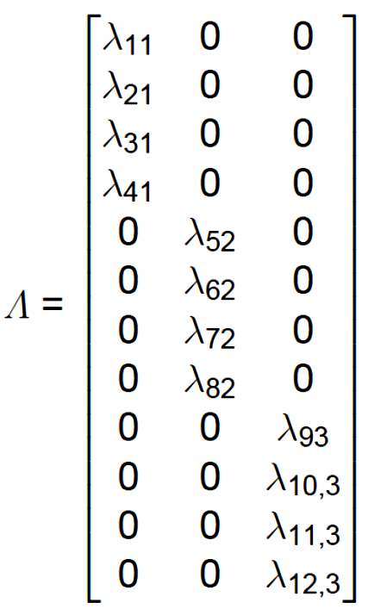
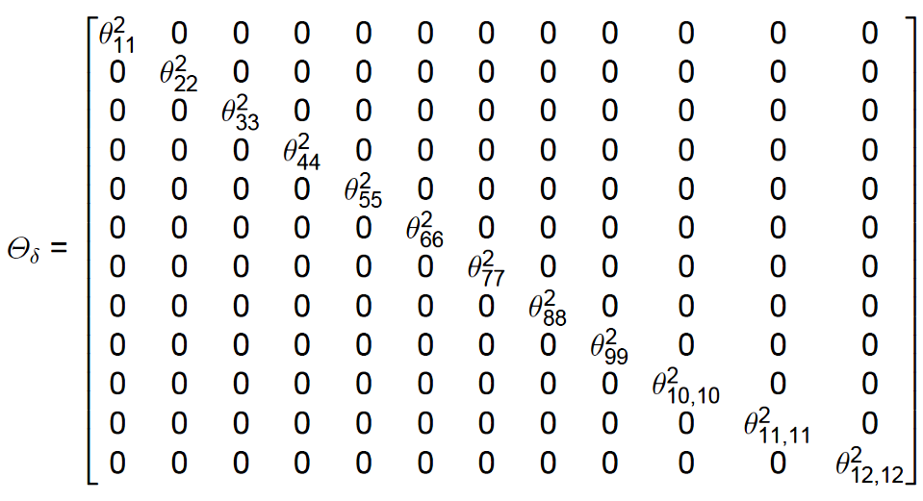
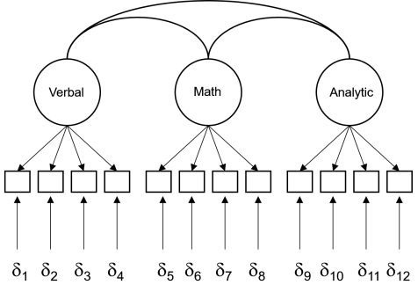
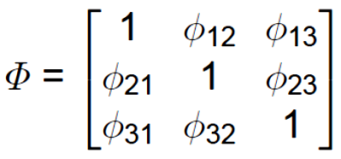

Slide 6
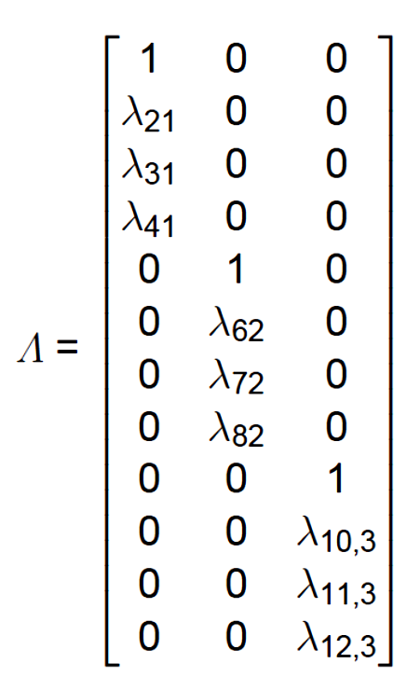
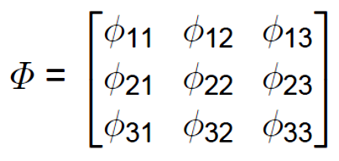

Slide 7
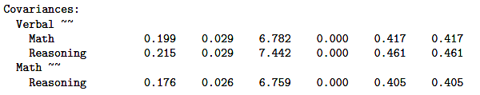
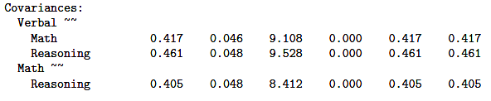
The same number of parameters are estimated, but the particular parameters that are estimated changes.
The standardized solutions are identical.

Slide 8
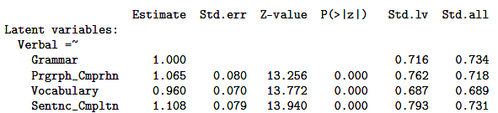
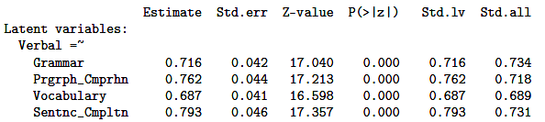
The same number of parameters are estimated, but the particular parameters that are estimated changes.
The standardized solutions are identical.

Slide 9
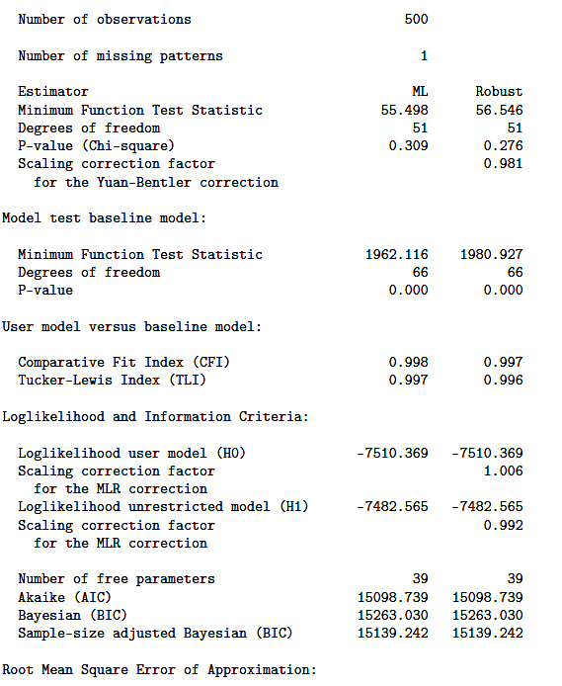
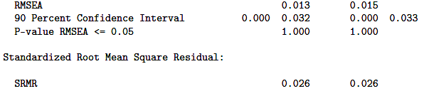
Identical goodness-of-fit statistics are provided by both approaches.

Slide 10
Analyzing Correlation
versus Covariance Matrices
Confirmatory factor analysis models are usually based on the decomposition of covariance matrices, not correlation matrices.
The solutions will differ to the extent that variables have different variances (these differences are removed with conversion to a correlation matrix).
Example data: Need for Cognition Scale (18 items) administered to 195 participants.

Slide 11
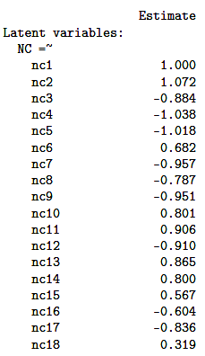

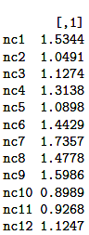
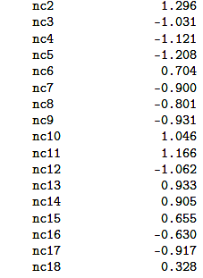
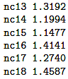
C
R
Variances
The impact of variables in an analysis of correlations will appear to shift as a function of the variances of those variables in relation to the variance-defining indicator.

Slide 12
  Model Modification
  When a presumed model does not fit, changes to the model can be tested for “goodness-of-fit,” but the exercise is no longer confirmatory and may capitalize on chance and other biases.
  It is surprisingly easy to find a good fitting model by trial and error.
  The example data come from a sample of students who completed the 18-item Need for Cognition Scale.

Slide 13
[ ] 1. I would prefer complex to simple problems.
[ ] 2. I like to have the responsibility of handling a situation that involves a lot of thinking.
[ ] 3. Thinking is not my idea of fun.
[ ] 4. I would rather do something that requires little thought than something that is sure to challenge my thinking abilities.
[ ] 5. I try to anticipate and avoid situations where there is likely a chance I will have to think in depth about something.
[ ] 6. I find joy in deliberating hard and for long hours.
[ ] 7. I only think as hard as I have to.
[ ] 8. I prefer to think about small, daily projects to long-term ones.
[ ] 9. I like tasks that require little thought once I’ve learned them.
[ ] 10. The idea of relying on thought to make my way to the top appeals to me.
[ ] 11. I really enjoy a task that involves coming up with new solutions to problems.
[ ] 12. Learning new ways to think doesn’t excite me very much.
[ ] 13. I prefer my life to filled with puzzles that I must solve.
[ ] 14. The notion of thinking abstractly appeals to me.
[ ] 15. I would prefer a task that is intellectual, difficult, and important to one that is somewhat important but does not require much thought.
[ ] 16. I feel relief rather than satisfaction after completing a task that required a lot of attention.
[ ] 17. It’s enough for me that something gets the job done; I don’t care how or why it works..
[ ] 18. I usually end up deliberating about issues even though they do not affect me personally.
Notes:
Each items is rated using the following scale:
1 = very characteristic of me
2 = somewhat characteristic of me
3 = neutral
4 = somewhat uncharacteristic of me
5 = very uncharacteristic of me

Slide 14
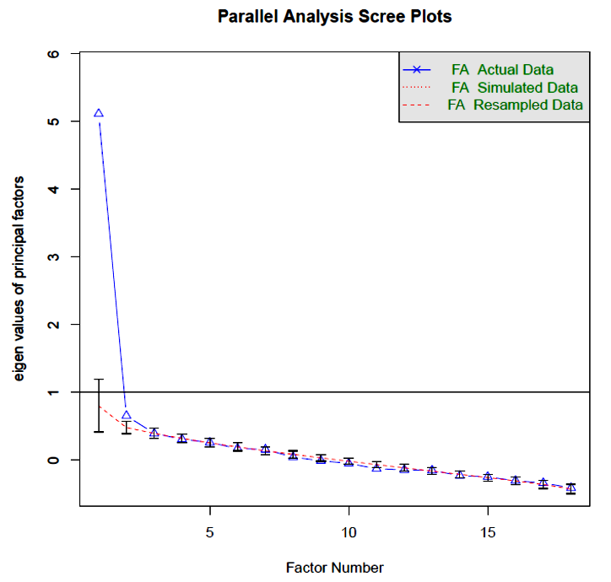
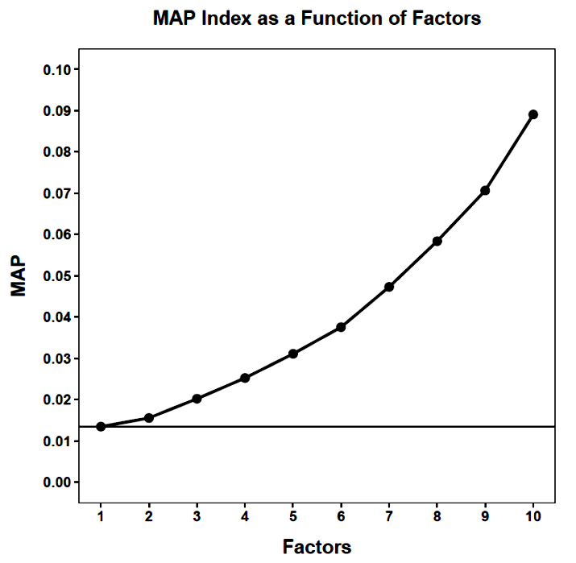
The conceptual model underlying the Need for Cognition Scale assumes a single latent variable. That seems sensible from these preliminary analyses.

Slide 15
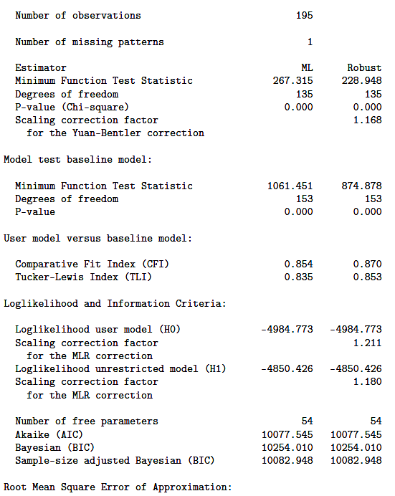
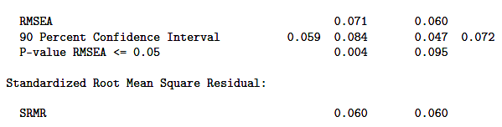
A one-factor CFA model is not a particularly good fit.

Slide 16
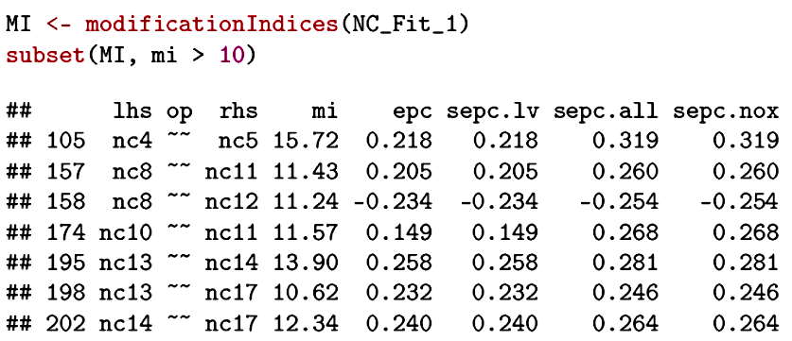
Most software, lavaan included, provides “modification indices” to help guide follow-up changes to an ill-fitting model. A modification index is the change in the goodness-of-fit χ² that would result from setting a parameter free.
The chi-square would be expected to be smaller by 15.72 if the error variances for Item 4 and Item 5 are allowed to correlate.

Slide 17
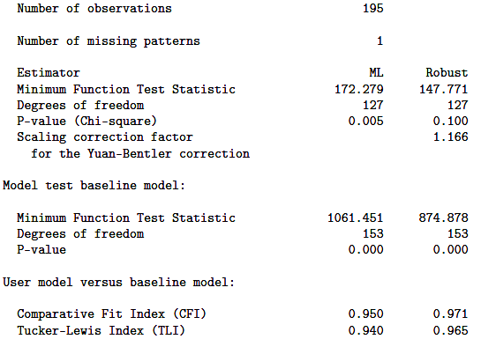
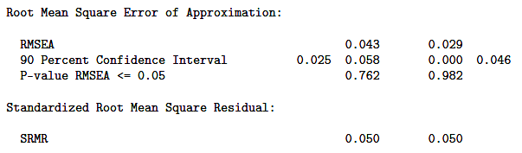
Successively removing the constraints associated with the largest modification indices will produce a better fit.
It may even produce an excellent fit. After 8 rounds, each time freeing an error covariance, the resulting model fits quite well. But does it make any sense?

Slide 18
NC.model.9 <- '
# Latent variable definitions.
NC =~ nc1 + nc2 + nc3 + nc4 + nc5 + nc6 + nc7 + nc8 + nc9 + nc10 + nc11 + nc12 + nc13 + nc14 + nc15 + nc16 + nc17 + nc18
nc4 ~~ nc5
nc13 ~~ nc14
nc8 ~~ nc11
nc8 ~~ nc12
nc10 ~~ nc11
nc5 ~~ nc12
nc2 ~~ nc4
nc14 ~~ nc17
'
There is no apparent pattern to the error variances that were freely estimated . . .

Slide 19
[ ] 1. I would prefer complex to simple problems.
[g ] 2. I like to have the responsibility of handling a situation that involves a lot of thinking.
[ ] 3. Thinking is not my idea of fun.
[a g] 4. I would rather do something that requires little thought than something that is sure to challenge my thinking abilities.
[a f ] 5. I try to anticipate and avoid situations where there is likely a chance I will have to think in depth about something.
[ ] 6. I find joy in deliberating hard and for long hours.
[ ] 7. I only think as hard as I have to.
[c d] 8. I prefer to think about small, daily projects to long-term ones.
[ ] 9. I like tasks that require little thought once I’ve learned them.
[e ] 10. The idea of relying on thought to make my way to the top appeals to me.
[c e] 11. I really enjoy a task that involves coming up with new solutions to problems.
[d f ] 12. Learning new ways to think doesn’t excite me very much.
[b ] 13. I prefer my life to filled with puzzles that I must solve.
[b h] 14. The notion of thinking abstractly appeals to me.
[ ] 15. I would prefer a task that is intellectual, difficult, and important to one that is somewhat important but does not require much thought.
[ ] 16. I feel relief rather than satisfaction after completing a task that required a lot of attention.
[h ] 17. It’s enough for me that something gets the job done; I don’t care how or why it works..
[ ] 18. I usually end up deliberating about issues even though they do not affect me personally.

Slide 20
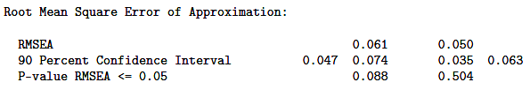
When possible, it is better to consider conceptually or methodologically sensible alternative models that might fit better than the original. One common measurement artifact is direction of scoring.
NC_N =~ NA*nc1 + nc2 + nc6 + nc10 + nc11 +
nc13 + nc14 + nc15 + nc18
NC_P =~ NA*nc3 + nc4 + nc5 + nc7 + nc8 +
nc9 + nc12 + nc16 + nc17
NC_N ~~ 1*NC_N
NC_P ~~ 1*NC_P
NC_N ~~ NC_P
This two-factor model is far simpler than the iteratively-modified model and fits reasonably well.

Slide 21
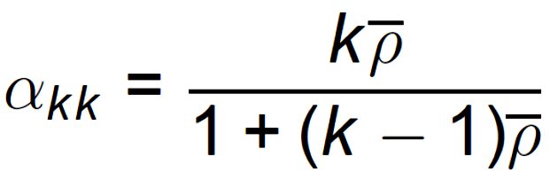
Reliability and Attenuation
Confirmatory factor analysis has a close relation to classical measurement theory. When the latent variable and observed variables are standardized, the λ are the correlations between each variable and the “true score.” The square of these λ are the individual item reliabilities (ρ_{ii}). If these are averaged (ρ), they can be used in the Spearman-Brown formula to provide an estimate of standardized coefficient alpha—an estimate of internal consistency:
_

Slide 22
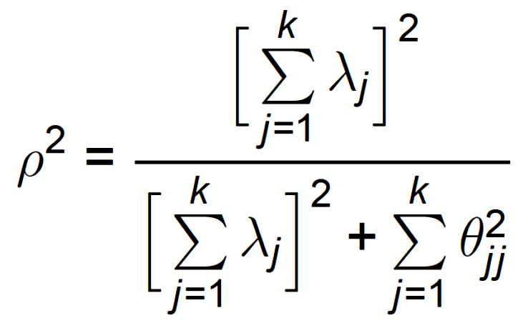
An alternative estimate of reliability uses the loadings and the error variances, resembling the variance ratio form for reliability:

Slide 23
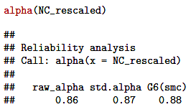
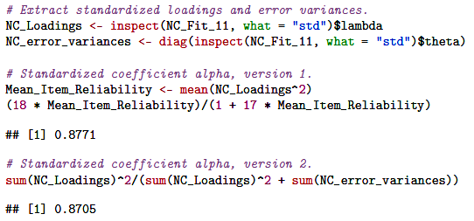
For the Need for Cognition data, the one-factor model parameter estimates yield reliability estimates that are very close to the traditional coefficient alpha:

Slide 24
φ_{VM}
Verbal
Math
Analytic
λ_{1V}
λ_{5M}
X₁
X₅
Inherent in the measurement model is the classical measurement theory notion of attenuation. The correlation between X₁ and X₅ is estimated by λ_{1V}φ_{VM}λ_{5M}.

Slide 25
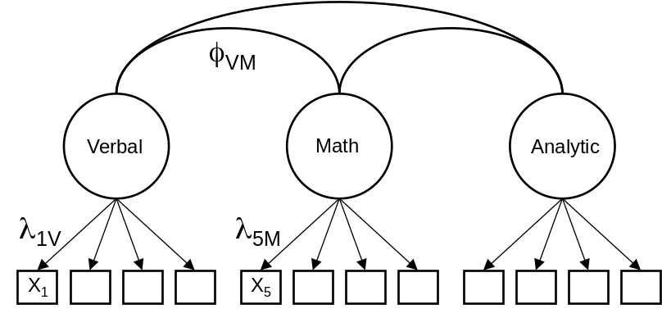






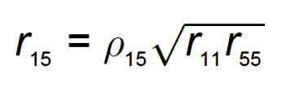

Slide 26
Measurement Invariance
In the context of confirmatory factor analysis, the goals of cross-validation are met through procedures designed to demonstrate measurement invariance.
Measurement invariance is motivated by the desire to infer group differences in latent variable means (and perhaps variances and covariances) that are not an artifact of measurement differences between the groups.
A scale has measurement invariance across
groups if identical levels of the latent variable have the same expected raw-score on the measure.

Slide 27
Group 1
Group 2
X₁
η
In this graph, the slopes (λ) and intercepts (τ) are the same, allowing group differences on the observed variable (X₁) to inform us about group differences on the latent variable (η).

Slide 28
Group 1
Group 2
X₁
η
The slopes (λ) are different in the two groups, making it possible that the groups could be the same on the latent variable (η) even though they exhibit differences on the observed variable (X₁).

Slide 29
Group 1
Group 2
X₁
η
The slopes (λ) are the same, but the intercepts (τ) are different in the two groups, making it possible that the groups could be the same on the latent variable (η) even though they exhibit differences on the observed variable (X₁).

Slide 30
Group 1
Group 2
X₁
η
If the slopes (λ) and the intercepts (τ) are different in the two groups, considerable error in inference about latent variable (η) differences is possible. Valid inferences about latent variables requires that the measures operate similarly in each group.

Slide 31
To determine if measurement invariance across samples is present, increasingly more stringent models are imposed and tested for equivalence.
The invariance testing process begins with estimation of the same basic factor model in each group. Configural invariance is said to exist if the same number of factors and similar patterns of loadings are found in all groups.

Slide 32
For this demonstration, the Holzinger & Swineford (1939) data will be examined. Nine cognitive abilities tests were administered to students at two schools. The tests are assumed to measure three correlated latent cognitive abilities: visual-spatial processing, text processing, and speed of processing.
HS.model <- '
Visual =~ x1+x2+x3
Textual =~ x4+x5+x6
Speed =~ x7+x8+x9
'
config <- cfa(HS.model,data=HS,missing="ML", estimator="MLR",
likelihood="wishart",representation="LISREL",
group="school")
summary(config,standardized=TRUE,rsq=TRUE,
fit.measures = TRUE)

Slide 33
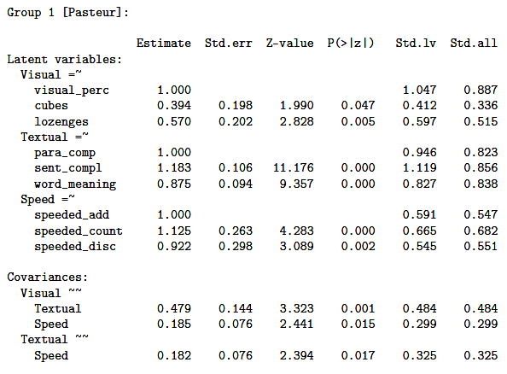
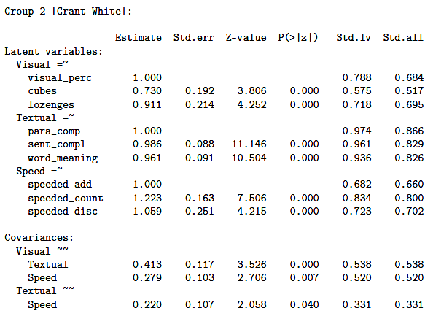
The loadings and latent variable correlations show similar patterns in the two groups. Configural invariance appears to hold.

Slide 34

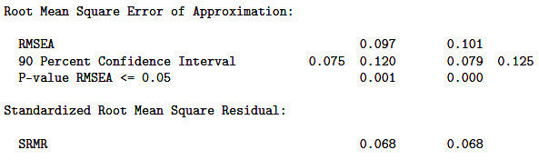
The fit, however, is not terrific, so we would probably want to explore that further before proceeding. We’ll forge ahead nonetheless in order to demonstrate the method.

Slide 35
The next constraint requires the factor loadings to be equal across groups. This constraint is called metric or weak invariance and tests whether respondents across groups attribute the same meaning to the latent constructs.
weak <- cfa(HS.model,data=HS,missing="ML",estimator="MLR",
likelihood="wishart",representation="LISREL",
group="school“,group.equal="loadings")
summary(weak,standardized=TRUE,rsq=TRUE,fit.measures = TRUE)
This model is compared to the configural invariance model using a chi-square difference. Invariance holds if the test is not significant. Comparison of CFI is also recommended, with invariance indicated by a difference < .01.

Slide 36



Weak invariance holds; the latent variables are interpreted the same way in each sample.

Slide 37
Next the intercepts are constrained to be equal. This is called scalar or strong invariance and implies that the meaning of the constructs (the factor loadings), and the levels of the underlying items (intercepts) are equal in both groups. If this constraint holds, the groups can be compared on their latent variable scores.
strong <- cfa(HS.model,data=HS,missing="ML",
estimator="MLR", likelihood="wishart",
representation="LISREL",group="school",
group.equal = c("loadings","intercepts"))
summary(strong,standardized=TRUE,rsq=TRUE,fit.measures = TRUE)
Implicit in this test (and the previous one) is the restriction that the latent means are constrained to be equal). Why?

Slide 38

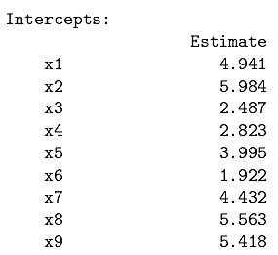
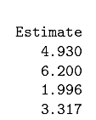
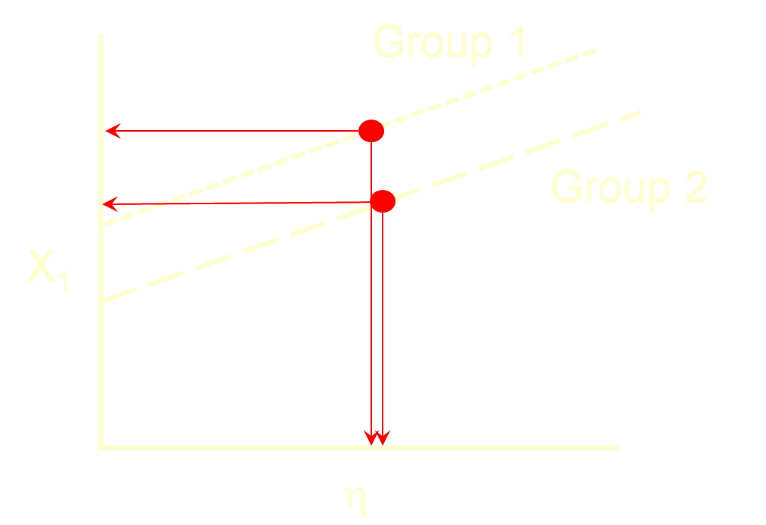

Strong invariance does not hold.

Slide 39
Finally, the residual variances are fixed to be equal across groups. This is called strict invariance and means that the explained variance for every item is the same across groups. In other words, the latent construct is measured identically across groups.
If error variances are not equal, groups can still be compared on the latent variable, but this is measured with different amounts of error between groups.
strict<- cfa(HS.model,data=HS,missing="ML",estimator="MLR",
likelihood="wishart", representation="LISREL",
group="school", group.equal=c("loadings",
"intercepts","residuals"))
summary(strict,standardized=TRUE,rsq=TRUE,fit.measures = TRUE)

Slide 40

The residual variances are similar. Had we passed the previous test, strict invariance would hold.
Additional steps could impose constraints on the latent variable means, variances and covariances.

Slide 41
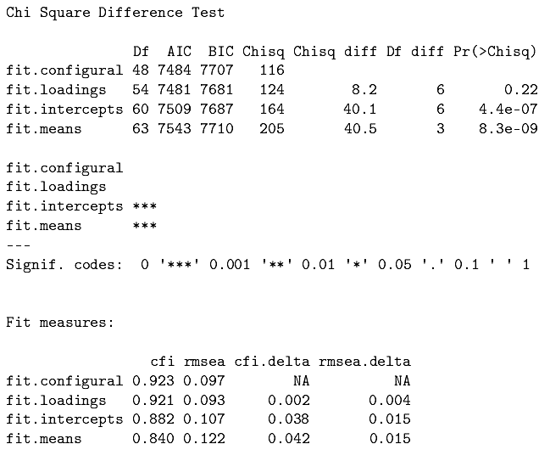
A convenient function can be used for the basic invariance tests, but it excludes strict invariance and replaces it with latent mean invariance:
measurementInvariance(HS.model, data = HS, group = "school")

Slide 42
Invariance can be tested with measures collected over time. All of the invariance constraints must be specified explicitly.
SE_Model_3 <- '
SE_1 =~ a*r_1_1 + b*r_1_2 + c*r_1_3 + d*r_1_4 + e*r_1_5 +
f*r_1_6 + g*r_1_7 + h*r_1_8 + i*r_1_9 + j*r_1_10
SE_2 =~ a*r_2_1 + b*r_2_2 + c*r_2_3 + d*r_2_4 + e*r_2_5 +
f*r_2_6 + g*r_2_7 + h*r_2_8 + i*r_2_9 + j*r_2_10
r_1_1 ~ aa*1
r_2_1 ~ aa*1
r_1_2 ~ bb*1
r_2_2 ~ bb*1
r_1_3 ~ cc*1
r_2_3 ~ cc*1
r_1_4 ~ dd*1
r_2_4 ~ dd*1
r_1_5 ~ ee*1
r_2_5 ~ ee*1
r_1_6 ~ ff*1
r_2_6 ~ ff*1
r_1_7 ~ gg*1
r_2_7 ~ gg*1
r_1_8 ~ hh*1
r_2_8 ~ hh*1
r_1_9 ~ ii*1
r_2_9 ~ ii*1
r_1_10 ~ jj*1
r_2_10 ~ jj*1
SE_1 ~ 0*1
SE_2 ~ 0*1
'
Strong invariance for the self-esteem data.

Slide 43
When used wisely, confirmatory factor analysis is a powerful tool that can test well-specified models and compare competing models.
Like any statistical procedure, however, it can be biased when it is used in a more exploratory manner (as in model modification).
In those cases, careful cross-validation is necessary to insure the validity of the best fitting model.

Slide 44
Next time . . .
Multidimensional scaling

